Slide 1
Jesus Commissions His Church
Understanding the Scriptures: Luke 24:44-49
Engage in Mission: Acts 1:6-8
Connect to Grow: Acts 2:41-47
This powerpoint is available at:
http://bensatterfield.weebly.com/
Lifeway (2013). God’s Story: Covenant, Community, Christ

Slide 2
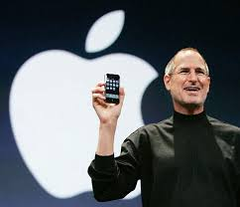
When You Launch Something, Go Big..
Notes:
When we launch something, we like to go big. When God Launches something He starts small…
Steve Jobs (Apple Computer) was the master of new product announcements…
IPod, IPad, IPhone
Huge venues, dramatic lighting, staging and presentation was meticulously scripted (Regis McKenna Agency)
Just enough info was leaked ahead of the announcement
so that expectations of what “The Next Big Thing” was going to be went through the roof
And when Steve would get to the “And One More Thing” part of the program…
(He always saved the biggest news for last)
People were on the edge of their seats, in a frenzy of anticipation and enthusiasm
What a contrast to the way Jesus launched His church:
Eleven rough & uneducated guys, gathered in an upper room
A somewhat anti-climactic message: Wait
No press kits, No webcasts, No invitations to potential bloggers
Just eleven men…
oh - And one more thing – the Holy Spirit

Slide 3
Understanding the Scriptures: Luke 24:44-49
⁴⁴ Now He said to them, “These are My words which I spoke to you while I was still with you, that all things which are written about Me in the Law of Moses and the Prophets and the Psalms must be fulfilled.”
⁴⁵ Then He opened their minds to understand the Scriptures,
⁴⁶ and He said to them, “Thus it is written, that the Christ would suffer and rise again from the dead the third day,
http://www.biblegateway.com/passage/?search=Luke%2024&version=NASB
Notes:
Sunday night
The women had gone to the tomb – found it empty
John/Peter went to see – puzzled
Confusion, uncertainty, fear, doubt
His most devoted followers (A-Team)
Disciples, mother, folks who followed them
Huddled behind locked doors
Then suddenly He appears
After He calms them down – He starts to announce His plan

Slide 4
Understanding the Scriptures: Luke 24:44-49
⁴⁷ and that repentance for forgiveness of sins would be proclaimed in His name to all the nations, beginning from Jerusalem.
⁴⁸ You are witnesses of these things.
⁴⁹ And behold, I am sending forth the promise of My Father upon you; but you are to stay in the city until you are clothed with power from on high.”
(Luke 24:44-49 NASB)
http://www.biblegateway.com/passage/?search=Luke%2024&version=NASB
Notes:
These verses are part of the post resurrection conversation with those who had assembled in Jerusalem.
Jesus appeared in the room. They were startled.
His first act was to bring peace to the room
And assure them that they were not seeing a ghost
But that it was Jesus that was resurrected from the dead
Can you imagine the wonder? Awe? Many questions.
A little reticence

Slide 5
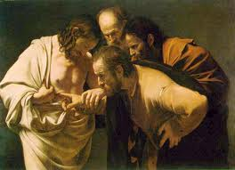
Jesus Appears
“These are my words that I spoke to you while I was alive.”
Connects what He is about to tell them to his teaching while he was with them and alive.
Notes:
Jesus had tried more than once to prepare the disciples for his death/resurrection
The never seemed to understand
Now He gets them to recall those conversations
All of this was supposed to happen – Exactly the way it did
It was all foretold in scripture
This was God’s plan

Slide 6
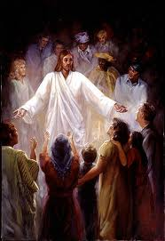
He Opened Their Minds to Understand
“These are my words that I spoke to you while I was alive…”
“…all things which are written about Me in the Law of Moses and the Prophets and the Psalms must be fulfilled.”
Notes:
Disciples needed for Jesus to connect the dots
Jesus went thru the scriptures
Not incidental. Coincidental, accidental
God revealed His sun and His purposes in the scriptures
In Jesus – it came to pass
Three division of the Hebrew Bible (Law, Prophets, Psalms)
Means God’s story is the story of His redemption of humanity thru the Messiah
It all points to Him
We have looked at Genesis, Exodus, Isaiah 53, Psalms 22
Do you now look at the old testament passages for how they point to Jesus?
This shows us something about reading scripture
It is not all about our intellect alone
It is a spiritual experience – Now the Holy Spirit who teaches us, Reveals Jesus (John 14:26)

Slide 7
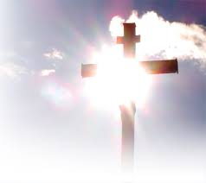
You Are Witnesses of These Things
“Thus it is written, that the Christ would suffer and rise again from the dead the third day,
and that repentance for forgiveness of sins would be proclaimed in His name to all the nations, beginning from Jerusalem.”
Notes:
Scripture foretold all of this, but…
Conflicted with popular view about Messiah
Believed he would come as a deliverer
Restore David’s Throne – glory days of Israel
Come in might – kick out the Romans
Jesus focused their attention to the scriptures
Especially Isaiah 53, Psalm 22
Even though he would suffer He would win ultimate victory over death (PS 16:8-11)
All nations would be blessed (Promise to Abraham Gen 12:2-3)
He was the seed of Abraham (Matt 1:1)
As they respond to the call to repent – remission of sin was available
Followers of Jesus would now proclaim this message (part of plan)
Do so in His name – with His personal authority
Starting in Jerusalem

Slide 8
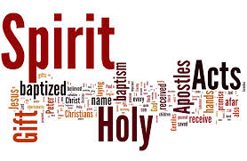
The Father’s Promise
“ I am sending forth the promise of My Father upon you;
…stay in the city until you are clothed with power from on high.”
John 14:26
Notes:
What is the promise Jesus is talking about?
Commission becomes explicit: You are my witnesses.
What you have see and heard in the scriptures
Has been fulfilled in person
You had a front-row seat.
Now go testify/witness to what you have seen & heard.
The Great Commission will be difficult
It is not something that can be done by human strength, will, insight alone
God will not send us to do a task w/out providing what is needed to accomplish it
Wait here in Jerusalem for the power to come
That power will enable them, clothe them
Ability to go & witness….

Slide 9
Engage in Mission: Acts 1:6-8
So when they had come together, they were asking Him, saying, “Lord, is it at this time You are restoring the kingdom to Israel?”
⁷ He said to them, “It is not for you to know times or epochs which the Father has fixed by His own authority;
⁸ but you will receive power when the Holy Spirit has come upon you; and you shall be My witnesses both in Jerusalem, and in all Judea and Samaria, and even to the remotest part of the earth.”
(Acts 1:6-8 NASB)
http://www.biblegateway.com/passage/?search=Acts%201&version=NASB
Notes:
God’s Word is an integral part
Not only of our private spiritual life
But of the effectiveness of the Church as a whole
Can we take the Word to the lost without knowing it first? Him first?
Knowing the Bible for ourselves may seem a daunting task –
If we know Jesus - we have a Helper…

Slide 10
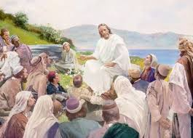
Restoration of the Kingdom?
“Lord, is it at this time You are restoring the kingdom to Israel?”
Not for us to know but God has a plan
Devote our energy to building the Kingdom of God
Notes:
What does this question reveal about the Disciples?
Disciples still see God’s sovereign rule as being realized in Israel – in a physical Kingdom – not a Spiritual Kingdom
See why Jesus wanted them to wait for Holy Spirit: wisdom, insight, empowerment
Notice Jesus does not answer this Q directly. He redirects their thinking
New direction more consistent with who He is as the Christ and the mission that is before them…
Times: chronological time
Seasons: events occurring in time : turns, cold, leaves fall – tells you seasonal change
Our knowledge of God’s timing for accomplishing His purposes – not what is important
These are under His power (Exousia – His authority, right to decide, right to rule)
The restoration of the kingdom of Israel would come about through the building up of the Kingdom of GOD
As disciples brought more & more into the fellowship of faith.
Such matters were set by Father God by His own authority and Plan.
Disciples should not expend energy on fruitless speculations
Jesus was preparing them to become full participants in God’s worldwide mission.

Slide 11
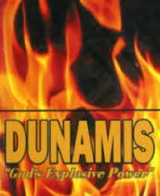
You Will Receive Power
Dunamis (Explosive, supernatural, creative power
1 Cor. 4:20 (Gospel not in words but Dunamis)
2 Cor. 12:9 (God’s Dunamis is perfected in our weakness
Notes:
Great Commission is beyond Human power to accomplish
God supplies the power
God will get the glory

Slide 12
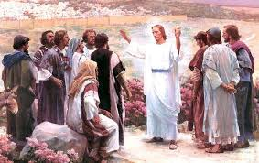
You Shall Be My Witnesses
“…you will receive power when the Holy Spirit has come upon you;
and you shall be My witnesses...
(martys)
…to the ends of the earth”
(eschatos)
Notes:
Power to…. (do what?)
Be my witnesses: Tell what you have seen/heard/experienced (1 Jn. 1: 1-4)
By the power He supplies (to whom, how, what) (John 15:26 – When HS comes – He will testify of me, so will you
HS not only working in us – He is working in the one to whom we speak
Witness (martys – gr.) life as a testimony
Jerusalem/Judea/Samaria/outermost parts of the earth: Concentric circles… expanding
Ends of the earth – (Eschatos) geogr. limits, time limits
Dunamis Power of God is not available to make us comfortable or address our wants
For the purposes of the Kingdom – accomplish God’s plan
Remember this is God’s Story

Slide 13
Connect to Grow: Acts 2:41-47
⁴¹ So then, those who had received his word were baptized; and that day there were added about three thousand souls.
⁴² They were continually devoting themselves to the apostles’ teaching and to fellowship, to the breaking of bread and to prayer.
⁴³ Everyone kept feeling a sense of awe; and many wonders and signs were taking place through the apostles.
⁴⁴ And all those who had believed were together and had all things in common;
http://www.biblegateway.com/passage/?search=Acts%202&version=NASB
Notes:
Look at Acts 2 - Start with verse 1-8 Dunamis power of God comes
Many people were assembled in Jerusalem from all over the region
God chose this moment to empower His witnesses
The disciples all spoke in unfamiliar languages., the languages of those who were assembled
Peter spoke with boldness – called for people to make a decision

Slide 14
Connect to Grow: Acts 2:41-47
⁴⁵ and they began selling their property and possessions and were sharing them with all, as anyone might have need.
⁴⁶ Day by day continuing with one mind in the temple, and breaking bread from house to house, they were taking their meals together with gladness and sincerity of heart,
⁴⁷ praising God and having favor with all the people. And the Lord was adding to their number day by day those who were being saved.
(Acts 2:41-47 NASB)
http://www.biblegateway.com/passage/?search=Acts%202&version=NASB

Slide 15
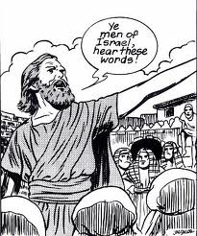
The Holy Spirit Comes
Acts 2:1-8
Empowers disciples to witness to those in Jerusalem
“Aren’t these men from Galilee?”
Peter speaks with boldness
3000 received the word, were baptized

Slide 16
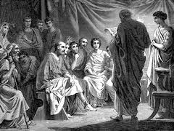
Four Priorities of the Early Church
Four Practices:
Teaching (didache)
Fellowship (koinonia)
Breaking of bread
Prayer
Results:
Fear & awe
Signs & wonders following
Notes:
Apostles doctrine – teaching (didache) Shared their experiences. Passed on instructions they had heard (insp. By Holy Spirit)
Fellowship (koinonia) root: to have “in common”
Deep associations – relationship – being together
One-in-the spirit - common faith, faith experiences
Sharing resources with one another – as needed (non econ. Equalization, but a desire to support those involved in the work of kingdom)
Generosity vs. obligation
Want to give
Breaking Bread – sharing meals – relationships thrive – opportunities to share/interact
Also could mean sharing the Lord’s Supper (likely both)
Prayer – prayer for one another
Formal – in context of worship
Private prayers – personal
People were in conversation with the Lord
Connected to one another/to the Father
Sense of awe and wonder pervaded the church
Healings & miracles
Everytime they got together there was the expectation that God would show up – something powerful would take place
In the church
Also observed in the community
Contributed to spiritual growth
Development of congregational unity
Development of missional expansion & ministry
These practices continue to be essential to effective ministry and growth

Slide 17
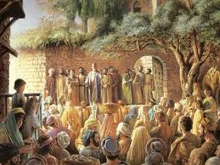
Continuing Daily in One Accord
Meeting one another’s needs
Gathering
in the temple
from house to house
With glad, generous, sincere hearts
Sharing meals with gladness
Having singleness of heart
Praising God
Notes:
Early Church were largely Jewish believers
Sought to be faithful to their Jewish heritage
Did not see themselves as opposed to Judaism – but as its fulfillment
Temple – where the people were
Effective place for evangelism
Jews understood/ familiar with scriptures – knew about Messiah – prophecies
Enjoyed being together – loved one another
It apparently was obvious to community watching

Slide 18
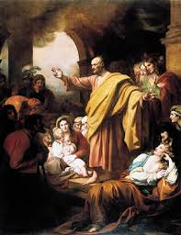
Favor and Outreach
“and having favor with all the people.
And the Lord was adding to their number day by day those who were being saved.”
Notes:
God honored the diligence of the early Church: Great Favor
the joy was appealing
the love was authentic – can’t fake this
If we want this kind of growth
Unity of the Church – base focus upon Jesus - not let little differences keep us apart
Love one another – stregthen the connections among us
Express Love to people outside the church
Bear witness to Christ – His impact in our life

Slide 19
Notes:
Be available to the Holy Spirit –
Gifts
Allow Him to work through us
Holy Spirit will add to our number – as He did in the first century

Slide 20
Resources
This powerpoint is available at:
http://bensatterfield.weebly.com/

