Slide 1
Jesus Is Crucified and Raised
Crucified Savior: Mark 15:33-39
Living Lord: Mark 16:1-7
Resurrection Faith: 1 Corinthians 15:17-19
This powerpoint is available at:
http://bensatterfield.weebly.com/
Lifeway (2013). God’s Story: Covenant, Community, Christ

Slide 2
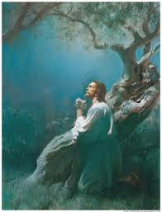
Timeline of Events
Thursday Evening
The Last Supper (Matthew 26:20-30; Mark 14:17-26; Luke 22:14-38; John 13:21-30)
In the Garden of Gethsemane (Matthew 26:36-46; Mark 14:32-42; Luke 22:39-45)
Jesus is Betrayed and Arrested (Matthew 26:47-56; Mark 14:43-52; Luke 22:47-53; John 18:1-11)
The Religious Leaders Condemn Jesus (Matthew 27:1-2; Mark 15:1; Luke 22:66-71)
Notes:
This morning we are going to examine the death and resurrection of Jesus in the context of God’s Story
Here is a brief summary of the sequence of events Thursday & Friday – leading up to & including to the crucifixion

Slide 3
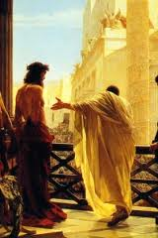
Timeline of Events
Friday: 6 a.m.
Jesus Stands Trial Before Pilate (Matthew 27:11-14; Mark 15:2-5; Luke 23:1-5; John 18:28-37)
Jesus Sent to Herod (Luke 23:6-12)
7 a.m.
Jesus Returned to Pilate (Luke 23:11)
Jesus is Sentenced to Death (Matthew 27:26; Mark 15:15; Luke 23:23-24; John 19:16)
8 a.m.
Jesus is Led Away to Calvary (Matthew 27:32-34; Mark 15:21-24; Luke 23:26-31; John 19:16-17)

Slide 4
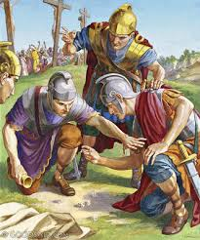
Timeline of Events
9 a.m. - "The Third Hour“
Jesus is Crucified on the Cross (Mark 15: 25)
Luke 23:34 - Jesus said, "Father, forgive them, for they do not know what they are doing."
Mark 15:24 -The soldiers cast lots for Jesus' clothing
10 a.m. Jesus is Insulted and Mocked
Matthew 27:39-40 - And the people passing by shouted abuse, shaking their heads in mockery. "So! You can destroy the Temple and build it again in three days, can you? Well then, if you are the Son of God, save yourself and come down from the cross!“
(Mark 15:31; Luke 23:36-37; Luke 23:39)
Notes:
He said almost nothing
Did not defend Himself

Slide 5
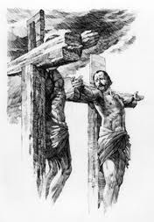
Timeline of Events
11 a.m.
Jesus and the Criminal (Luke 23:40-43)
Jesus Speaks to Mary and John (John 19:26-27 )
Noon - "The Sixth Hour"
Darkness Covers the Land (Mark 15:33)
1 p.m.
Jesus Cries Out to the Father (Matthew 27:46)
Jesus is Thirsty (John 19:28-29)
2 p.m.
It is Finished (John 19:30; Luke 23:46)

Slide 6
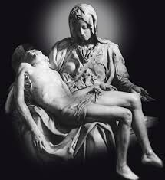
Timeline of Events
3 p.m. - "The Ninth Hour“
The Earthquake (Matthew 27:51-52)
The Centurion - "Surely he was the Son of God!" (Matthew 27:54; Mark 15:38; Luke 23:47)
The Soldiers Break the Thieves' Legs (John 19:31-33)
The Soldier Pierces Jesus Side (John 19:34)
Before 6 p.m.
Jesus is Laid in the Tomb (Matthew 27:57-61; Mark 15:42-47; Luke 23:50-56; John 19:38-42)
Notes:
This is where we will join the story of Jesus’ death and resurrection

Slide 7
Mark 15:33-39
³³ When the sixth hour came, darkness fell over the whole land until the ninth hour.
³⁴ At the ninth hour Jesus cried out with a loud voice, “Eloi, Eloi, lama sabachthani?” which is translated, “My God, My God, why have You forsaken Me?”
³⁵ When some of the bystanders heard it, they began saying, “Behold, He is calling for Elijah.”
http://www.biblegateway.com/passage/?search=Mark%2015:33-39&version=NASB
Notes:
It is Noon on Friday.. The 6th hour
Mark’s account
Written for the benefit of Gentiles so he translates…

Slide 8
Mark 15:33-39
³⁶ Someone ran and filled a sponge with sour wine, put it on a reed, and gave Him a drink, saying, “Let us see whether Elijah will come to take Him down.”
³⁷ And Jesus uttered a loud cry, and breathed His last.
³⁸ And the veil of the temple was torn in two from top to bottom.
³⁹ When the centurion, who was standing right in front of Him, saw the way He breathed His last, he said, “Truly this man was ^{[g]}the Son of God!”
http://www.biblegateway.com/passage/?search=Mark%2015:33-39&version=NASB

Slide 9
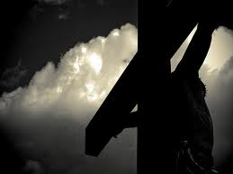
Darkness
“When it was noon, darkness came over the whole land until three in the afternoon.” (Mark 15:33, NIV)
Notes:
In earlier parts of God’s story: darkness portended divine judgement
as the 3 days of darkness preceeding the death of the firstborn in Egypt (Ex 10:21-23)
Or Amos description of the Day of the Lord as a day of darkness and not light (Amos 5:18-20)
Over the whole land referred to a considerably large area –
most likely the entire region of Judea
Dust storm?
Solar Eclipse?
Everyone saw the darkness eerie, massive
The God of Creation brought this about

Slide 10
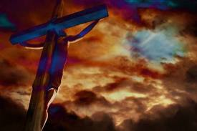
Forsaken?
Ninth hour (3 pm)
Jesus cried out with a loud voice, “Eloi, Eloi, lama sabachthani?” which is translated, “My God, My God, why have You forsaken Me?”
Psalm 22:1
Notes:
Did this catch Jesus by surprise?
Did God forsake Jesus?
At face value one could understand Jesus calling out these words
He did nothing wrong
He never sinned, was crucified between two criminals, mocked, abused
forsaken, denied, apparently abandoned by God
Look at Psalm 22:1
Was Jesus reciting Psalm 22 in its entirety? (A psalm of David) It is the plaintive cry of one suffering alone
Seems appropriate –
psalm begins with these words
and recounts the torments of an unnamed individual who maintains faith in the Lord.
Read Psalm 22 and look for parallels with Jesus’ death
Could be an honest expression of His humanity
And as an appeal to scripture, knowing in the end God (and His Word) would triumph.
Recall the emmontional distress Jesus experienced in the Garden of Gathsemane
He prayed – “take this cup from me” “if it be your will”
He resolved to be obedient to God’s plan
Drink the cup, Take on our sin
Knowing it would separate Him from the Father
That which He dreaded most had come to pass

Slide 11
Psalm 22: 22-31
²² I will tell of Your name to my brethren; In the midst of the assembly I will praise You.
²³ You who fear the Lord, praise Him; All you descendants of Jacob, glorify Him, And stand in awe of Him, all you descendants of Israel.
²⁴ For He has not despised nor abhorred the affliction of the afflicted; Nor has He hidden His face from him; But when he cried to Him for help, He heard.
http://www.biblegateway.com/passage/?search=Psalm%2022&version=NASB

Slide 12
Psalm 22: 22-31
²⁵ From You comes my praise in the great assembly; I shall pay my vows before those who fear Him.
²⁶ The afflicted will eat and be satisfied; Those who seek Him will praise the Lord. Let your heart live forever!
²⁷ All the ends of the earth will remember and turn to the Lord, And all the families of the nations will worship before You.
http://www.biblegateway.com/passage/?search=Psalm%2022&version=NASB

Slide 13
Psalm 22: 22-31
²⁸ For the kingdom is the Lord’s And He rules over the nations.
²⁹ All the prosperous of the earth will eat and worship, All those who go down to the dust will bow before Him, Even he who cannot keep his soul alive.
³⁰ Posterity will serve Him; It will be told of the Lord to the coming generation.
³¹ They will come and will declare His righteousness To a people who will be born, that He has performed it.
http://www.biblegateway.com/passage/?search=Psalm%2022&version=NASB
Notes:
Psalm 22 concludes with a cry of victory – an affirmation that God will deliver
Can’t know if Jesus was reciting the whole Psalm
But we can be pretty sure that this cry was an indication that He did NOT believe God had turned his back on Him – forever
Feeling of abandonment- identify with us in our suffering
Conviction that God’s plan is in motion

Slide 14
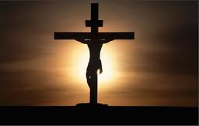
Psalm 22
What does it say about Jesus’ mindset that He was quoting scripture right up to His death?
What does it say to us?
Notes:
What does it say about Jesus’ mindset that He was quoting scripture right up to His death?
What does it say to us? Life-changing events can come upon us quickly – prep by hiding the word in our hearts (got to already be there)
Rather than focus upon the excruciating elements of the crucifixion and death of Jesus
Mark shows Jesus in Control
Jesus execution was
Not an act of jealous religious leaders
Cruel Roman soldiers
Paniced politicians
No one took Jesus life from Him
He GAVE his life in submission to Father’s will
His death was full of purpose – conceived in the eternal mind of God
Jesus never lost control
Never lost sight of what was ultimately taking place.

Slide 15
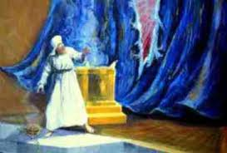
The Curtain Was Split
Symbolized:
The way of access to God had been opened by Jesus (Hebr. 4:14-16).
The temple–based sacrificial system was rendered invalid (Hebr. 9:8-15).
The coming destruction of the temple by the Romans.
Notes:
You recall that this was the curtain that separated the Holy Place (inner court)
from the Holy of Holies where the Ark of Covenant was kept.
where only the priests could go only once a year on the Day of Atonement.
Now in permanent Temple – same separation created by a massive heavy curtain
At 3PM Torn from top to bottom (not something men might accomplish easily)
No agent identified – just happened
At the same moment as Jesus said “It is finished”
From this point forward Jesus, not temple priesthood would be one’s access to God’s throne (Hebr. 4:14-16)
¹⁴ Therefore, since we have a great high priest who has passed through the heavens, Jesus the Son of God, let us hold fast our confession. ¹⁵ For we do not have a high priest who cannot sympathize with our weaknesses, but One who has been tempted in all things as we are, yet without sin. ¹⁶ Therefore let us draw near with confidence to the throne of grace, so that we may receive mercy and find grace to help in time of need.”
The new covenant was established and OT system of sacrifice was not longer needed
The torn curtain symbolized the destruction of the temple 40 yrs. later at the hands of the Romans.

Slide 16
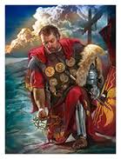
The Centurion
“This man really was God’s Son!” (Mark 15:39, NIV)
Confirming Jesus as Christ
Foreshadow spread of Gospel to Gentiles
Notes:
In general, how had those witnessing this crucifixion responded (Mark 15: 35-36)? (Taunting, mocking)
What made the Centurion certain of Jesus identity? (he watched Him die – revealed who he was)
He stood in front of Jesus facing him from 9 am to 3 pm (maybe earlier?)
Saw & heard the taunts- observed Jesus response
Jesus cried out in strength then quickly dies (They broke the legs of the other men to hasten their death)
No struggle to save His life – freely gave it
The Centurion is the 2nd confirmation of Christ as Messiah (Christology) in Mark
1st by high priest in Mark 14:61 - “Messiah son of the blessed one”
Despite their positions relative to Jesus – out of their mouths they confess that He is the Christ
Question for us today….
How do we respond to others when we go through difficulty?
Could they tell we are followers of Christ?

Slide 17
Mark 16:1-7
When the Sabbath was over, Mary Magdalene, and Mary the mother of James, and Salome, bought spices, so that they might come and anoint Him.
² Very early on the first day of the week, they came to the tomb when the sun had risen.
³ They were saying to one another, “Who will roll away the stone for us from the entrance of the tomb?”
⁴ Looking up, they saw that the stone had been rolled away, although it was extremely large.
http://www.biblegateway.com/passage/?search=Mark%2016:1-7&version=NASB
Notes:
Jesus was in control
Neither He nor the Father was surprised by His death –
But what about those following Jesus ?
We can only imagine how the disciples and those following Jesus must have felt
There is little in scripture to tell us…
But we do get a glimpse of the joy they experience as they learn of His resurrection.

Slide 18
Mark 16:1-7
⁵ Entering the tomb, they saw a young man sitting at the right, wearing a white robe; and they were amazed.
⁶ And he *said to them, “Do not be amazed; you are looking for Jesus the Nazarene, who has been crucified. He has risen; He is not here; behold, here is the place where they laid Him.
⁷ But go, tell His disciples and Peter, ‘He is going ahead of you to Galilee; there you will see Him, just as He told you.’”
http://www.biblegateway.com/passage/?search=Mark%2016:1-7&version=NASB

Slide 19
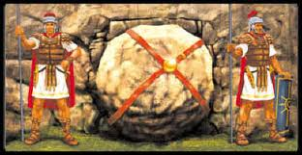
The Women Faced Obstacles
There was a stone in front of the tomb.
Roman soldiers stood guard.
They had killed Jesus what were they going to do to His followers?
Notes:
Look at the Women’s preparation:
They were intent on annointing Jesus body – it was what needed to be done
Mission of Love
Saturday night they went and bought spices to prep the body
Chose to follow thru despite obstacles / odds of failure
They just showed up…
Supernatural act – stone removed, soldiers gone
We all may be able to learn something here
How often do we shrink back from the things we should do – because of perceived obstacles?
We dread facing challenges
Only to find that obstacle not really there?
Human tendancy to worry about problems – magnify them

Slide 20
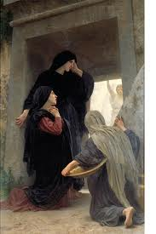
Inside the Tomb
Angel says:
Don’t be alarmed
He was crucified, died
He was raised
See for yourself
Go tell the disciples…
…and Peter
Notes:
First words of the young man/angel: “Don’t be afraid/alarmed”
Sound familiar? Angel to Mary (Luke 1:30), Angel to Zechariah (Luke 1:13), Angel to Shepherds (Luke 2:10)
Presence of an Angel – disturbing? They always say “fear not”
Angel
Affirms the mission of the women
Confirms the reality of Jesus death – no doubt as to the outcome of the events of Friday (no deception, no ruse)
He was crucified, He died,
But He is risen
He is risen (actually was raised ) passive voice
Someone did the raising – implication Act of God
“Behold see the place..” see for yourself
The women heard, they saw. Angel gave them a mission
Go your way:
Gave them a mission: Tell the disciples and Peter
Go meet Jesus in Galilee
Why single out Peter? Denials (Mark 14:16-72)

Slide 21
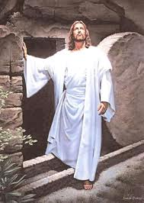
1 Corinthians 15: 17-19
¹⁷ and if Christ has not been raised, your faith is worthless; you are still in your sins.
¹⁸ Then those also who have fallen asleep in Christ have perished.
¹⁹ If we have hoped in Christ in this life only, we are of all men most to be pitied.
http://www.biblegateway.com/passage/?search=1%20Corinthians%2015:%2017-19&version=NASB
Notes:
Jesus’ resurrection is important: (Paul was correcting the misconception of some folks at Corinth)
Historical fact of Jesus substitutionary death and resurrection is the basis for our faith
Resurrection gives meaning to who Jesus is (son of God) and the significance of the crucifixion
The fact that Christ is alive today sets Him apart from all other religious figures of history
Resurrection is essential for forgiveness and defeat of sin and victory over the grave
If He was not resurrected then neither shall we be…
Those who are dead (in Christ) have no eternal hope
Resurrection is the assurance of a meaningful life in eternity
God’s plan involves Jesus coming again – to make things right
We shall be resurrected
and we shall have a role to play in the eternal plan
V 19 - Why would we be pitied?
In Our life here we are victorious because we live in anticipation of a future hope
It is an assurance of faith
And yet the Western Church has – for most of the 20th Century – has not placed much emphasis upon the Resurrection that is to come
We have celebrated Christmas as the major festival of the Church
When for 19 centuries the Church celebrated Easter and the Resurrection as the most important celebration on the calendar

Slide 22
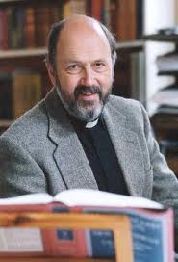
Resurrection
“If you say Jesus died and nothing happened but the disciples had some interesting ideas, then you have cut off the branch on which classic Christianity is sitting. This generation needs to wake up, smell the coffee and realize serious Christianity begins when Jesus comes out of the tomb on Easter morning. This is not a nice optional extra for those who like believing in funny things.” N.T. Wright
http://www.christian.co.uk/people-have-very-odd-ideas-about-jesus-p1281
Notes:
NT Wright Anglican Church Scholar – former Bishop of Durham – a leading theologian & scholar among evangelicals
Book: Surprised By Hope addresses the resurrection of Christ and the resurrection awaiting believers and how that should change our present outlook on this life and this world.
The Resurrection is talking about “Life after life-after-death” – (Study in some detail the last Sunday of August)
He is coming back – in bodily form (and so are we)
And when He does He will renew and restore all things
(Stay Tuned)

Slide 23
How Does the Resurrection Impact Our Lives?
Are our primary motivations eternal or temporal? Where are you on the continuum of each of these questions?
I tithe because:
I want God to bless me…………………………I want God’s work in world to advance
I pray because:
I need help………………………………………….………………..I need to connect with God
I come to Church because:
I get a lot out of the sermon …………………………………God deserves my worship
I read the Bible and pray with my family because
I want my family to know the Bible …………………………….. My family needs Jesus
Lifeway (2013). God’s Story: Covenant, Community, Christ, Personal Study Guide p.94
Notes:
It seems so basic Jesus lived died conquered death and lives today.
But it is the central undeniable can’t believe god without it Centerpiece to the entire bible
All of the old testament points to it
All of the rest of the new testament points back to it
It changed everything about god’s relationship with man
With the Israelites and with the world (John 3:16).
His death and life has much more than a global impact
It affects each individual life in ways we can’t imagine Until we trust him with every aspect of our lives
We should want to know him or everyday And learn to depend fully on the power that raised him from the dead
Which he makes available to us in our own lives

Slide 24
Resources
This powerpoint is available at:
http://bensatterfield.weebly.com/

