Slide 1
God Sends His Son
The Son’s Identity (John 1: 1-2,14)
The Son’s Purpose (John 1: 11-13,18, 29)
The Son’s Ministry (Matthew 4: 17-24)
This powerpoint is available at:
http://bensatterfield.weebly.com/
Lifeway (2013). God’s Story: Covenant, Community, Christ

Slide 2
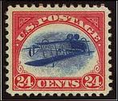
If you were a collector…
and you came across something you knew was:
unique,
highly sought after
in good condition
what would you do?
Notes:
Not a philatelist -
Only 1 sheet of 100 of these 1918 airmail stamps made it into circulation. Oct 2005 auction, block of 4 sold for $2.5 Mil.
John 3:16 says God sent his ONE AND ONLY Son.
From what have we learned so far in our study, is it clear to you that God planned from the beginning to send His Son?

Slide 3
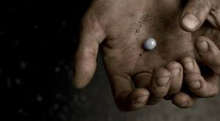
The Pearl of Great Price
“Again, the kingdom of heaven is like a merchant seeking fine pearls, and upon finding one pearl of great value, he went and sold all that he had and bought it. “(Matt. 13:45-46, NASB)
Notes:
Jesus compared the Kingdom of God to a merchant of fine pearls who sold everything he had in order to purchase a pearl of great value.
In today’s passages we are going to see how Jesus is like that pearl. He is unique, what He provides is highly sought after, and he is in “perfect condition”. We will see how Jesus is uniques in his identity, purpose, and ministry.

Slide 4
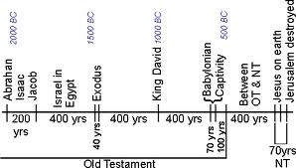
God’s Story

Slide 5
John 1
¹ In the beginning was the Word, and the Word was with God, and the Word was God.
² He was in the beginning with God. (John 1: 1-2, NASB)
http://www.biblegateway.com/passage/?search=John%201&version=NASB

Slide 6
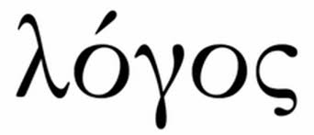
The Word (from Strong’s Concordance)
3056. logos log'-os from 3004; something said (including the thought); by implication, a topic (subject of discourse), also reasoning (the mental faculty) or motive; by extension, a computation; specially, (with the article in John) the Divine Expression (i.e. Christ):--
Notes:
Logos – the expressed word (as in spoken, thought, calculated - including motive)
It is the expression of ….
In this case (John uses the article “the”) the Divine Expression of God
Logos was familiar to both Jews and Greeks of the 1st Century
Jews: Word – recalled God’s creative power – at creation God spoke
AND God continued to speak thru His prophets
Greeks: Word – was the expression of “Rational Principle of Life” (Reason / Wisdom)
“in the beginning Reason was”
For both cultures John was saying there was a wisdom that came from a source beyond themselves
The WORD was divine power
Life principal All together in a person: Jesus
Reason/Wisdom

Slide 7
In the beginning….
“¹ In the beginning was the Word...”
Logos
“…and the Word was with God, and the Word was God.”
Logos was with God (Theos)
Logos was Theos
Notes:
John’s use of “in the beginning” is a clear reference to the Hebrew account of story of Creation
(“the” indicates a fixed point – so Jesus was before the creation) (Reason precedes the creation)
Uses this to anchor what he is saying in Hebrew scriptures
Reiterates this in verse 2….
He proclaimed the Logos was with God and was God
His Hebrew readers would have understood “Theos” as the God they worshiped YAHWEH
Vs 1 & 2 “The Word was…” or “HE was” Connects with Jews understanding of the name of God (I AM)
EX 3:14 Moses: “Who shall I say sent me?” Answer “Tell them, I AM sent you”
God has no timeline: He was God, He is God (I am), He will be God
Not a new story, filling in blanks of the original story
In the beginning… Jesus already was – says so much about reverence and recognition deserved by Jesus
Jesus was not an afterthought
Not Plan B – He was an integral part of creation – THE plan all along: THE Reason
Now we see looking back how God foreshadowed Him in his instructions to the Hebrew people comg out of Egypt and going into the promised land.
Goal the same: to dwell, have relationship

Slide 8
John 1
¹⁴ And the Word became flesh, and dwelt among us, and we saw His glory, glory as of the only begotten from the Father, full of grace and truth. (NASB)
http://www.biblegateway.com/passage/?search=John%201&version=NASB
Notes:
LOGOS (Reason, Wisdom) did something new
Took the form He had never taken previously
Stepped into time: He manifested himself in time/space
The eternal creator of all things – in whom is all wisdom and rational logic
Became a specific person at a specific time (4 BC)
Yet He still retained His divine nature
Now He was God incarnate – God in the flesh

Slide 9
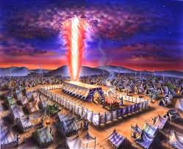
The Word Dwelt Among Us
“And the Word became flesh, and dwelt among us, and we observed His glory...”
skēnoō
to fix one's tabernacle, have one's tabernacle, abide (or live) in a tabernacle (or tent), tabernacle
to dwell
Notes:
The Word tabernacled; i.e. lived temporarily –dwelt among us…
Literally: “pitched His tent”; take up residence
Made His dwelling
Jesus took up his place as the center of the faith community
Clearly this is pointing back to The Tabernacle and The Presence of God in the midst of the 12 tribes
This is not a new story but a revelation about the old
Skenoo: tabernacle – tent of meeting/ tent of worship (OT)
Center of the camp during the 40 Years in desert
Represented the presence of God in their midst
Temporal (with us temporarily) vs. eternal (permanent home in Heaven)
The WORD came to dwell among men
For a temporary period of time
In flesh – in the person of Jesus

Slide 10
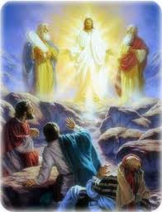
His Glory
“and we saw His Glory…”
Saw (beheld): a long sustained look at..
Glory of God expressed in Jesus
God’s manifest presence with power
Notes:
In Jesus Christ we see God’s presence in a way
superior to
unlike
Any other shown before
Ministry: Preaching, teaching & Healing – demonstrating
When we experience the presence of God, we are changed

Slide 11
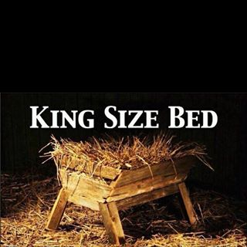
Only Begotten
“the only begotten from the Father”
Monogenēs:
One and only
One-of-a-kind
Begotten – used here refers to
Logos and the Father
Eternal connection
Notes:
For the first time in John’s Gospel, God is called “Father”
John revealed the deep relationship between the one & only Son and the Father as he progressed thru the Gospel
Begotten (in this case): emphasizes eternal connection Logos + Father
rather than refer to the incarnation
The manner in which God himself is coming to be with us
thru Jesus the Word has become flesh

Slide 12
Grace
“..full of grace and truth.”
Grace: Charis (unmerited favor)
Ex 34:6. God says “I am rich in faithful love and truth.”
Promise to Abraham (Gen. 22:18) fulfilled: “In your seed all the nations of the earth shall be blessed,” (NASB)
Notes:
We were able to behold His glory – full of Grace & Truth
Full – complete, perfect, lacking nothing
Trusth implies trustworthy
Grace (Charis) God’s compulsion to grant His favor even when it is not deserved
In Jesus we see God’s Grace and Truth expressed together
Jesus becoming flesh fulfills God’s plan to bless all peoples through Abraham (Gen 22:18)
Jesus dwelt among us as a Son of Abraham (Matt 1:1)
And as the preexistent Word of God (John 1:1)
The term “full” reminds us that Jesus’ grace and truth was the complete expression
of God’s love for sinful humanity
Truth - Price for our sin had to be paid – could not ignore or disregard (Just - God didn’t change the rules – played by them))
Grace - Love and compassion toward us demonstrated while we were sinners

Slide 13
John 1
¹¹ He came to His own, and those who were His own did not receive Him.
¹² But as many as received Him, to them He gave the right to become children of God, even to those who believe in His name,
¹³ who were born, not of blood nor of the will of the flesh nor of the will of man, but of God. (NASB)
http://www.biblegateway.com/passage/?search=John%201&version=NASB

Slide 14
John 1
¹⁸ No one has seen God at any time; the only begotten God who is in the bosom of the Father, He has explained Him. (NASB)
http://www.biblegateway.com/passage/?search=John%201&version=NASB
Notes:
Jesus reveals God to us…..enabling us to follow Him and to have our sins taken away
In this passage we see 5 distinct elements of His purpose

Slide 15
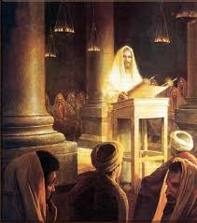
The Son’s Purpose
1. To reach his own people
God had called Hebrews to be a holy nation and kingdom of priests (Ex 19:6)
Jesus reached out to them
However many of His own did not receive Him
Notes:
This passage reveals 5 things about Jesus’ purpose in coming….
1. To reach His own people.
His own (idios) 2X in this passage – Private or particular to oneself
First is neuter in gender (His own land or country)
Second is masculine in gender (His own people)
He came to His own, but His own received Him not….
We know the story… Jesus preached the good news, explained the scriptures, performed miracles
And those who should have recognized Him, did not
Red Flag for us today? So much access to God’s word, good teaching, TV, radio, podcasts, streaming video,
Danger for established traditional religion
Pharisees – had the Word of God – studies it – knew it
We have come to see: all pointed to one man: Jesus – the expression of the God they thought they knew
Yet when He came and stood before them, lived in their midst,
They did not recognize him.
Contrast this with story of Anna & Simeon (Luke 2)
Devout
Searching for
Anticipating the return of
They knew by the spirit when His parent brought Jesus into the same room (Temple) with them

Slide 16
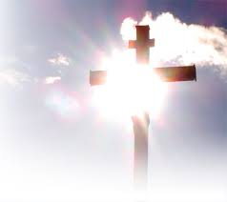
The Son’s Purpose
2. To redeem all who would receive Him
“Redeem” from slave trade meaning to purchase freedom of one who is in slavery
Receive (in Greek means to “take hold” or “to accept” as truth)
To receive Him is to believe on His name
Believe (in Greek means “continuing action”)
“He gave them the right to be children of God”
“Right” (in Greek indicates “authority”)
Notes:
2. To redeem all who would receive Him
To receive implies to reach out and intentionally appropriate for oneself; accept His words as truth (not passive)
To believe implies ongoing action (not a single action in isolation).
Salvation is not a matter of mere intellectual assent to theological propositions
To believe on the name of Jesus means to buy into every aspect of His character and purpose
His Name: Christ/ Messiah Savior
John has identified Him W/ the Father – so He is also LORD
Jesus gives those who do believe on His name/ receive Him the RIGHT to be children of God
His authority conferred for this purpose
Highest status in life for which we can hope to attain
Sins forgiven, Eternal life for sure – but starts now…

Slide 17
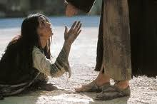
The Son’s Purpose
3. To manifest the will of God.
Rebirth
Spiritual vs. human flesh
Will of God vs. will of man
Notes:
3. To manifest the will of God.
Jesus likened becoming a child of God to being Born Again – rebirth in a spiritual sense
Not like human birth – mingling of blood of 2 families, will of flesh (man’s desire) to have offspring
Rather because of the will of God
V13 - New Birth into God’s family starte with what God did in Christ….
Comes from God alone – part of relationship with Him
We can not appropriate this for ourselves
Can not achieve it by man-made works
The life we have in Christ is Christ’s life in us….
Born of spirit, not flesh. Not for the purpose of resuming our pursuit of earthly pleasures
but our pursuit of God’s will for our lives…

Slide 18
The Son’s Purpose
4. To reveal God (John 1:18)
“No one has ever seen God”
Jesus unique relationship with Father
One and only Son
At Father’s side
Jesus revealed Him (Gr. ~exegesis)
Notes:
4. To reveal God (John 1:18)
Jesus is in an unique position
As the one and only Son of God and situated at the Father’s side (Indicates a unique relationship)
Jesus reveals God to us
Revealed (in Greek)renders the word exegesis which is a term for “interpretation“ “explanation”
Thru His life, death, resurrection, teaching, preaching, miracles
Jesus has revealed God to us

Slide 19
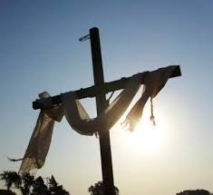
The Son’s Purpose
5. To take away the world’s sin (John 1:29)
John the Baptist calls attention to Jesus:
“Behold the Lamb of God…
“who takes away the sin of the world!”
Sin vs. sins
Sins of the world
Notes:
5. To take away the world’s sin ( Look at John 1:29)
Sin vs. sins – note the distinction
OT: Once sins are atoned for (sacrifice) we still have a sin problem (sin nature) Our human nature will sin again
NT: Jesus has freed us from sin nature
World: inclusive of all people (sinners)
Invite them to believe on His Name (John 1:12)
Receive Him
Sins are taken away…. Set free from sin-nature

Slide 20
Matthew 4:17-24
¹⁷ From that time Jesus began to preach and say, “Repent, for the kingdom of heaven is at hand.”
¹⁸ Now as Jesus was walking by the Sea of Galilee, He saw two brothers, Simon who was called Peter, and Andrew his brother, casting a net into the sea; for they were fishermen.
¹⁹ And He *said to them, “Follow Me, and I will make you fishers of men.”
²⁰ Immediately they left their nets and followed Him. (NASB)
http://www.biblegateway.com/passage/?search=Matt%204&version=NASB

Slide 21
Matthew 4:17-24
²¹ Going on from there He saw two other brothers, James the son of Zebedee, and John his brother, in the boat with Zebedee their father, mending their nets; and He called them.
²² Immediately they left the boat and their father, and followed Him.
²³ Jesus was going throughout all Galilee, teaching in their synagogues and proclaiming the gospel of the kingdom, and healing every kind of disease and every kind of sickness among the people.(NASB)
http://www.biblegateway.com/passage/?search=Matt%204&version=NASB

Slide 22
Matthew 4:17-24
²⁴ The news about Him spread throughout all Syria; and they brought to Him all who were ill, those suffering with various diseases and pains, demoniacs, epileptics, paralytics; and He healed them. (NASB)
http://www.biblegateway.com/passage/?search=Matt%204&version=NASB

Slide 23
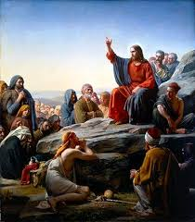
The Son’s Ministry
Jesus preached:
Repent (Metanoeo, Gr.)
The Kingdom of Heaven is at Hand
His ministry was marked by
Preaching (Kerusso, Gr.) proclaim good news
Teaching (didasko, Gr.) practical application
Healing
“Are you the One…?” (Luke 7:22)
Notes:
Repent: Metanoeo Gr. to think differently or change direction, i.e. reconsider (morally, feel compunction):--repent.
To turn; having a transformative effect, new direction, imply change of lifestyle
KOH/KOG at hand – Matthew uses term Kingdom of Heaven, other gospel writer use Kingdom of God
Talking about same thing:
Jesus arrival announces KOG is near/at hand – rule and reign of God
Jesus’ earthly existence fulfilled many of the prophecies & anticipations of the OT
Already / Not Yet
His Ministry:
Preaching: proclaiming the Good News (God has made a way for you to enjoy fellowship with Him)
Teaching: Answer Q’s: How do we enter the KOG? How shall we live in the KOG?
Discipleship: model the Kingdom lifestyle
Healing: changed individuals and demonstrated His power
Ministered to them at their point of need
If we are “Christians” (followers of/ little Christs) what marks our ministry?
How can we be more like Jesus?

Slide 24
The Son’s Ministry
Gone Fishin’ ?
Notes:
When Jesus calls His disciples:
Jesus interrupts the lives of these men to invite them to follow Him.
What was their response?
What does their immediate response to follow say about their faith? Curiosity?
How do we respond when God calls upon us to follow his directions? Are we faithful & obedient?
Nets: social relationships
Our web of/ sphere of influence
What are similarities between fishing for fish and fishing for people? What ways not?
If this analogy is effective, what are the nets?

Slide 25
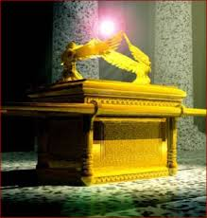
The Son’s Ministry
Notes:
God’s plan has been to dwell with His people and to have relationship with them
He lives in us – His Law is written on our hearts and His Spirit – the Holy Spirit – living within us
We have relationship with Him - this was His plan all along
His Kingdom is at hand
We now have his ministry (reconcilliation) ‘til He comes:
Draw others to know Him, have relationship with Him
Disciple them, teach them, model for them how to live in the Kingdom
Heal them – show up & allow God to touch their lives through us –
minister to their needs
Demonstrate the compassion that flows from His heart
Go fishing

Slide 26
Resources
This powerpoint is available at:
http://bensatterfield.weebly.com/

