Slide 1
Tablets and Apps Compared
Georgia Tools for Life
www.gatfl.org
July 11, 2013

Slide 2
Ben Satterfield, Ed.D.
AT Specialist/ Trainer/ Research Consultant
GA Tools for Life/AMAC
Georgia Institute of Technology
Ben@gatfl.org
Assistant Professor
Communication Sciences & Special Education
bsatt@uga.edu
Research Consultant
Center for AT Excellence
Ben@center4ATexcellence.com
Center4ATExcellence

Slide 3
Impact of Apps & Tablets
With the introduction of Apps, we are experiencing a drastic technology evolution that is revolutionizing the field of Assistive Technology and producing positive life changing results for individuals with disabilities.
Apps are assisting students by promoting more independence, increasing opportunities for inclusion, promoting depth of learning, providing equal access in educational settings and supporting smoother transitions.
This session will provide participants with opportunities to explore tablets and their accessibility features as well as learn about some apps that can assist students at school.

Slide 4
Agenda
Tools for Life Overview
Understanding the Difference between Android & Apple
Closer Look at Tablets
Considering Accessibility
Access the Tools For Life AppFinder
Exploring a Few of Tools for Life Favorite Apps

Slide 5
AMAC
AMAC Accessibility is a social change organization on a mission to create affordable services for governmental, private and non-profits organization working with individuals with disabilities. Services include e-text, braille, captioning, assistive technology, office management software and consulting.

Slide 6
Accessibility Made Smart
AMAC creates practical solutions that work, with a focus on utility,
ease of use, and high quality.
Accessibility Consulting focuses on organizational accessibility needs with evaluation, technical assistance, customer support, and website accessibility solutions.
Braille Services produces customized projects from both print materials and electronic text including partial books and chapters or graphics only using cutting-edge technology.
Captioning Services makes classrooms, meetings, labs and other audio environments fully accessible for deaf or hard-of-hearing.
Professional E-Text Producers provide high-quality e-text in many formats such as PDF, DOC, DAISY, and HTML.
Certified Assistive Technology team provides on-site and remote assessments, demonstrations, training and technical assistance for education, work, and daily living environments.
For more information, please visit our website at www.amacusg.org

Slide 7
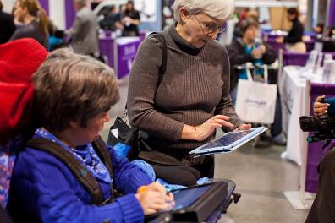
Tools for Life Mission
We’re here to help Georgians with disabilities gain access to and acquisition of assistive technology devices and assistive technology services so they can live, learn, work, and play independently in the communities of their choice.

Slide 8
Tools for Life Georgia’s Federal AT Act Program
TFL developed Georgia’s Plan for AT
We serve individuals of all ages & all disabilities in Georgia
Over 50,000 thru various activities throughout the year
TFL Network
Assistive Technology Resource Centers
Lending Libraries
Training and Demonstrations
AT Reuse
AT Funding Education/Assistance and Resources
Online Resources
www.gatfl.org - 12,000 unique visitors a month

Slide 9
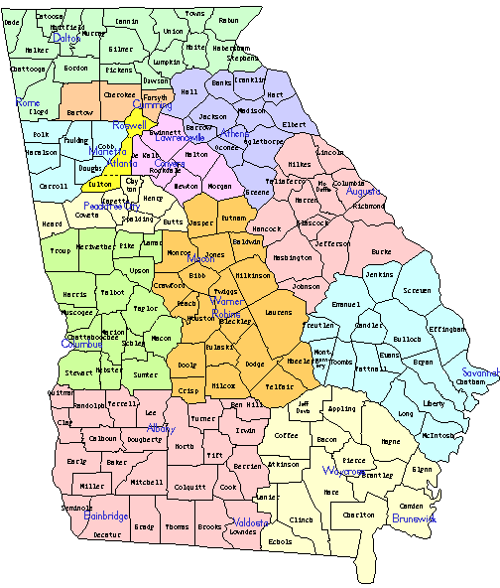
Tools for Life Network
AT Lending Library
AT Evaluations & Training
AT Demos
Resource and Assistance
AT Funding Assistance
DME Reuse
Center4ATExcellence

Slide 10
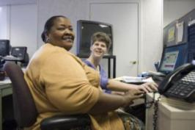
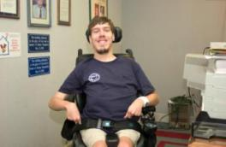
Who are We Serving
People with disabilities are the largest minority group in America.
This group cuts across racial, ethnic, religious, gender and age boundaries.
Anyone can become a member of this minority group at any time.
Over 54,000,000 individuals in the United States have disabilities that affect their ability to:
see
hear
communicate
reason
walk
perform other basic life functions
Public Law 108-364

Slide 11
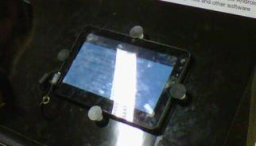
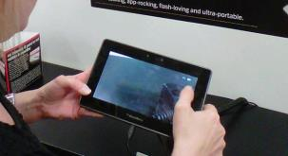
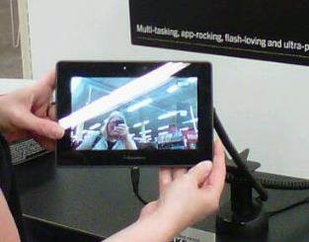
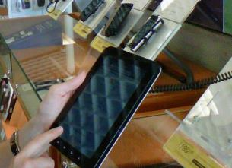
Android & Apple
Notes:
MR

Slide 12
Which One???

Slide 13
So how do you like that new iPad?
http://www.youtube.com/watch?v=R6WuHzE-1fk

Slide 14
LET’S TAKE A LOOK AT SOME OPTIONS
Notes:
MR

Slide 15
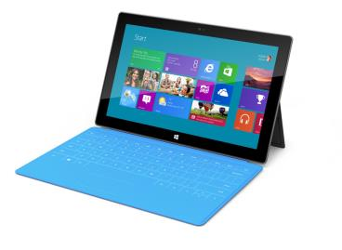
Microsoft Surface
Windows 8
Slim and has a USB port
Moveable Tiles
Built-in Accessibility
Speech-to-text
Narrator
Thin pressure sensitive cover that doubles as a keyboard
Surface starts at $499
RT now $350
Notes:
Windows Apps purchased at Windows Store Apps not Android (Asus & Samsung woking on a tablet to run both Android & Windows apps)
Surface will not run Android (at least not yet)
RT & Pro versions of Surface
RT Mouse support
Wifi Only
Good cameras (2)
Poor battery relative to iPad mini

Slide 16
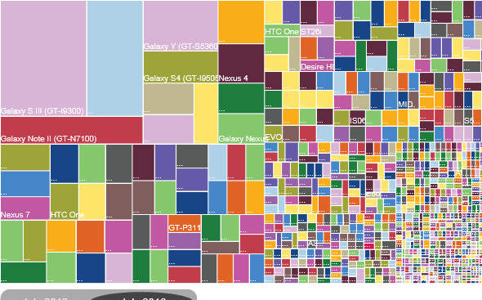
Android Device Fragmentation
July 2012: 3,997
Different Android Devices
July 2013: 11,868
Different Android Devices
July 30, 2013 http://www.ign.com/articles/2013/07/30/heres-what-android-fragmentation-looks-like
Notes:
OpenSignal took a look at all the different Android devices that downloaded its app, and what version of the OS the 682,000 sample devices were running. When the site ran the same test last year, they noticed 3,997 individual Android devices. But in 2013, there's an astonishing 11,868 unique Android devices in the wild. If you need a visual representation what that looks like, check out the chart in this slide.
Samsung accounted for 47.5 percent of all Android devices, with Sony-Ericsson taking the second place spot with only 6.5 percent. But hardware fragmentation is only part of the issue--there's also the matter of OS version. Over 37 percent of all Android users are running Jelly Bean, but 34 percent are still utilizing 2.3 Gingerbread. Comparatively, 95 percent of Apple's devices had upgraded to iOS 6.
OpenSignal rightly points out that fragmentation can be a positive for consumers. Clearly, Android devices offer increased variety, and with rumors of a cheaper iPhone on the horizon, even Apple may see the benefits of widening its hardware lineup.
suspicious that Android vendor-specific customizations are hindering Google’s efforts to make the user-interface more accessible – esp. to blind or low-vision users.

Slide 17
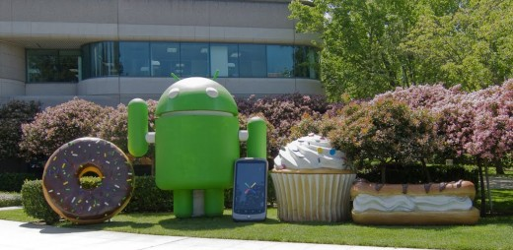
Android Version History
Android 1.5 Cupcake
Android 1.6 Doughnut
Android 2.0 Eclair
Android 2.3 Gingerbread
Android 3.0 Honeycomb
Android 4.0 Ice Cream Sandwich
Android 4.1 Jelly Bean
Android 5.0 Key Lime Pie ???
Notes:
Each version is different enough with regard to accessibility – need to know what version on what tablet.
Tablet manufacturers may change/enhance features so that access is different from tablet to tablet within same version of OS

Slide 18
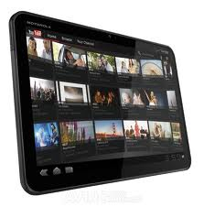
Motorola XOOM
Android System
Must download accessibility features
Compatible with Flash
Camera
Wi-Fi
Uses micro SIM card for external storage
Starts at $319.00

Slide 19
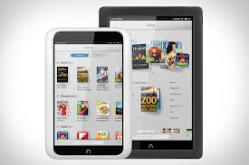
Nook HD
eBook Reader and mobile tablet
No Camera
Access to shop both Google Play Store and Barnes and Noble
Purchase apps
Starts at $129

Slide 20
Amazon Kindle
Kindle Fire
Proprietary version of Android
Amazon Kindle store for apps
7 in and 10 in screens
Hi-Res display
Dual speakers w/ Dolby Digital Plus
Up to 10 hrs. battery life
Camera: 1 mp. (front)
Starts at $199

Slide 21
Samsung Galaxy 3
Android OS: Jelly Bean with TouchWiz
8 & 10 in, screens available
5-megapixel camera microSD card slot
Comes bundled w/ 50 MB Dropbox
8 hr. battery use
Starts at $299 for 8 in, with $399 for 10 in.
Notes:
TouchWiz is a front end touch interface developed by Samsung Electronics with partners, featuring a full touch user interface

Slide 22
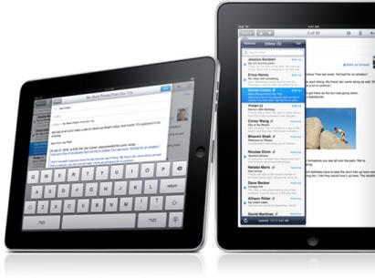
Apple iPad
Multi- touch screen
New iOS 6
Millions of apps
Surf web
iTunes
Videos
Organization
Accessibility
Books
Photos
Speakers
New iPad had 5.0 megapixel camera
Starts at $499/$399
Height: 9.50 in
Width: 7.31 in
Depth: 0.37 in
Weight: 1.44 lb

Slide 23
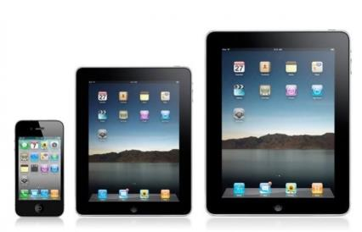
Apple iPad mini
Multi - touch screen
New iOS 6
Millions of apps
Surf web
iTunes
Videos
Organization
Accessibility
Books
Photos
Speakers
5.0 megapixel camera
Starts at $329
Height: 7.87 in
Width: 5.3 in
Depth: 0.28 in
Weight: 0.68 lb

Slide 24
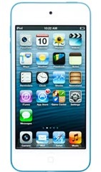
Apple iPod Touch
5 Megapixal Camera
Millions of apps
Videos
Surf Web
Voice Over
Organization
Speakers
Bluetooth
New iOS 6
Starts at $299 / $199 4th gen
Notes:
CP and MR
24

Slide 25
Refurbished Tablets
If you do not need the latest and greatest consider an older models for a discount
Want to make sure that refurbish tablets have been certified
Look for at least 1 year warranty
Many places now sell
Apple
BestBuy
Amazon

Slide 26
CONSIDERING ACCESSIBILITY
Notes:
MR

Slide 27
Comparing Tablets www.bluebugle.org - 12/17/2012
Property | Android | iOS | MS Windows | Amazon Kindle | Barnes & Noble Nook
Number and variety of tablets | Several | iPad & iPad Mini | A few | Kindle Fire & Fire HD | Nook HD
Operating System | Android (latest Jelly Bean) | Apple iOS 6 | Windows RT & Windows 8 Pro | Modified version of Android ICS | Modified Android ICS
Apps | Nearly 700,000 (including the ones not optimized for tablets specifically) | Total of 700,000, out of which 275,000 optimized for iPad & Mini | Around 100,000 (including phone apps) of which most are plain junk. | Around 60,000 (from Amazon’s special app store for Android) | Around 10,000 (available from Barnes & Noble store for Android)
Software Updates | As it becomes available on Google (for Nexus, directly, and for other manufacturers, as they become available) | Apple releases updates | MS releases updates | Amazon releases updates | BN releases updates
Interface | As designed by manufacturer (on Nexus line, the original unaltered Android interface) | Icons & widgets designed by Apple similar to Mac OS | Metro style designed by Microsoft | Modified version of regular Android interface (known to be slightly better looking) | Modified Android (criticized for worse looks)
Notes:
MR

Slide 28
Layout of the iPad

Slide 29
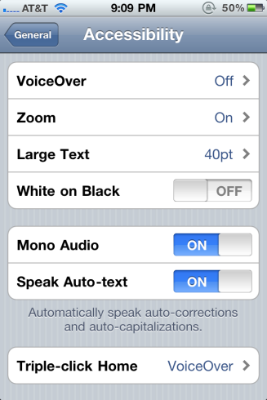
Built-in Accessibility Features
VoiceOver
Zoom
Large Text
Invert Colors
(white on black)
Speak Selection
Speak Auto Text
Mono Audio
Assistive Touch
Guided Access
Home-Click Speed
Incoming Calls
Braille Displays

Slide 30
VoiceOver
Standard feature on iPhones, iPads, and iTouches
World’s first gesture-based screen reader
DOES NOT WORK WITH ALL APPS
Does not work with many eBooks or textbooks
Works with built-in apps
Built-in voices that speak 36 languages
Adjustable speaking rate
Echoes each character as you touch it when typing or can speak completed word instead.
Speak Auto-text
Has the rotor
Works with all built-in applications

Slide 31
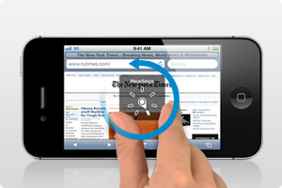
Helpful tips for VoiceOver
The Rotor
Virtual control
Rotating 2 fingers on the screen like a dial
Changes the way VoiceOver (VO) moves through a document based on setting
Can use to navigate through web pages

Slide 32
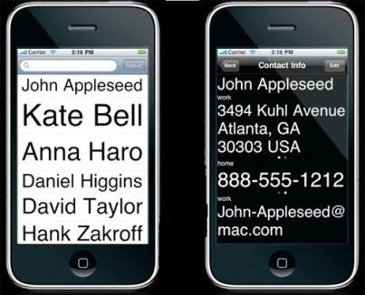
Zoom & Invert Colors
Zoom
Magnify entire screen of any application
Double-tap with 3 fingers
Can magnify 100%-500%
Now work with VoiceOver on!
iOS 6 September 2012
Invert Colors
Reverse video effect works in all applications
Can be used with Zoom and VoiceOver

Slide 33
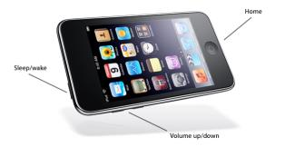
More Features
Tactile buttons
Easily discernible buttons
Large Text
Increase font size up to 56-point text in alerts, Calendar, Contacts, Messages, and Notes

Slide 34
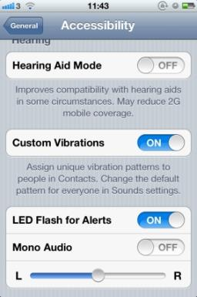
Hearing
Mono Audio
Custom Vibrations for iPhone
Assign unique vibrations patterns
Change default in Sounds setting
Create you own custom vibrations
Save and name it
LED Flash for Alerts
Answer calls in Speaker Mode or Headset
Accessibility => Incoming Calls
Visual Voicemails
TTY mode
FaceTime (Wifi)
Closed Captioning
Supports playback of open captions, closed captions, and subtitling

Slide 35
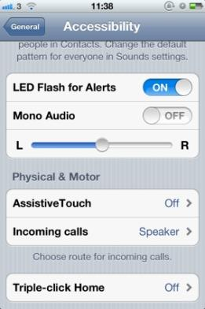
Assistive Touch
Lets you enter Multi-Touch gestures using one finger or stylus
Create custom gestures
Supports the use of adaptive input devices
Headsets and switches
Change Tracking Speed

Slide 36
Creating Keyboard Shortcuts
Go to General => Keyboard and make sure Shortcut is turned on
Go to Add New Shortcut
Put in your Phrase
Create Short Cut
Example:
Phrase : Martha E. Rust, MS CRC
Shortcut is: MER
So when MER is typed it will put in the above Phrase
OMW => On My Way!

Slide 37
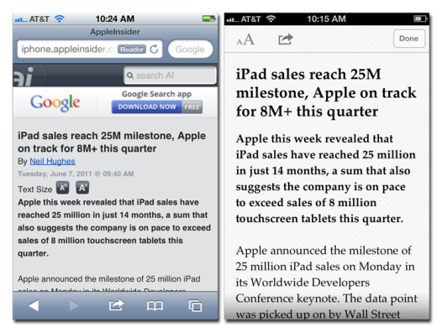
Reader for Websites
Read articles and web pages without distractions
Clutter disappears
Add link into Reading List and finish later

Slide 38
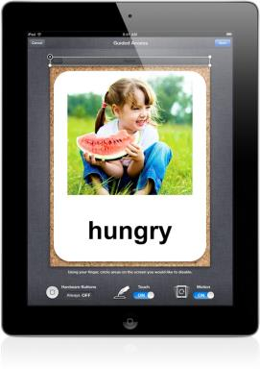
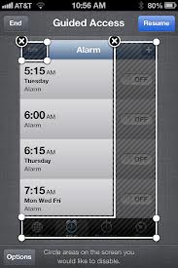
iOS 6 NEW: Guided Access
Helps remain on task and focus
Limit to one app / turn off home button
Restrict touch input on certain areas of the screen

Slide 39
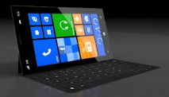
Surface
2 types
RT
PRO
RT
Cannot download software
Does not support digital pen
Built in MS Office
Word, Powerpoint, Excel
Pro
30 day trial of MS Office
Ability to download software
Open 3 Windows
Tiles
Start screen
Charms
Right hand side
Notes:
Works with Office Documents (Office 365)

Slide 40
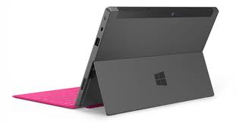
Layout of Surface
Power Button
Camera
Speaker
Micro USB
USB
Charger
On Left Side
Speaker
Headphone Jack
Volume control

Slide 41
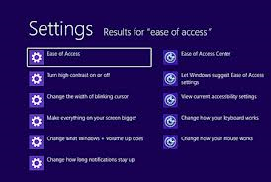
Accessibility of Surface
Uses Windows 8
Ease of Access
Narrator
Magnifier
On-Screen Keyboard
Windows Speech Recognition

Slide 42
Some Surface Apps
Maluuba
Personal assistant app
Apollo
Can be a calendar
See when the sun sets and rises
Barcode Generator
Free way to create your own barcodes
Notes:
RT: 60K apps
PRO: all windows Apps

Slide 43
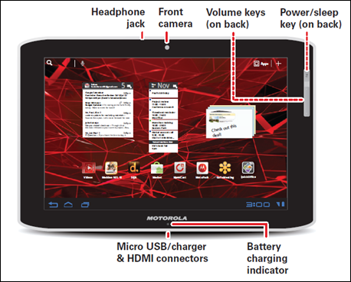
Layout of XOOM

Slide 44
Layout of the Nook HD
Volume
Head phones
Power
Home Key
Charger

Slide 45
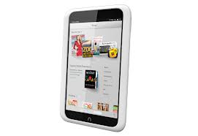
Nook HD
Download Books and Movies
Access to Barnes and Noble Store
Access to Google Play Store
No Camera
Does not read books out loud
Note taking features
Can Change:
Font
Line Spacing
Text Size
Background color

Slide 46
Amazon Kindle
Accessibility emerging
Voice Over in Kindle iOS app to read content on iPad (coming later on other platforms).
Look up words in dictionary, Wikipedia
Customize reading by adjusting font size, color etc.
Use iOS features like Zoom, Assistive Touch, Stereo to Mono as well as peripheral braille displays
Notes:
Focus initially upon individuals with visually impairments…

Slide 47
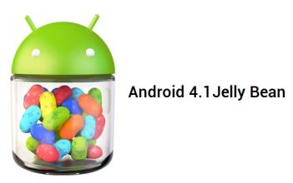
Android Tablets
Accessibility features are not built in
Talkback, Kickback, and Soundback
Gesture Feature in Jellybean
Eyes - free keyboard
IDEAL Web Reader for internet
No zoom or contrast right now
What operation system is tablet running
Jellybean, Ice cream sandwich, Honeycomb, Gingerbread
Google Play Store to buy apps
Must have Gmail address
Can use Amazon gift cards
Not the best to use with someone who has low vision and/or blind or cognitive disabilities
Notes:
Android vendor-specific customisations are hindering Google’s efforts to make the user-interface more accessible esp. to blind or low-vision users.
Example: Voice-over (iOS) as you roll your finger across the screen, anything that is underneath it will announce itself. Home screen icons, text fields, buttons, the keyboard— pretty much any element in iOS is identifiable with VoiceOver.
Android 4.0 (aka Ice Cream Sandwich) called Explore by Touch. Explore by Touch is essentially the same concept as VoiceOver; being able to navigate & explore the interface of your phone by moving your finger around.
Trouble is, on the HTC One X it really doesn’t work.
Almost every element of Android on the HTC One X has been customised by HTC with their own user interface elements, which they have named ‘Sense UI’.

Slide 48
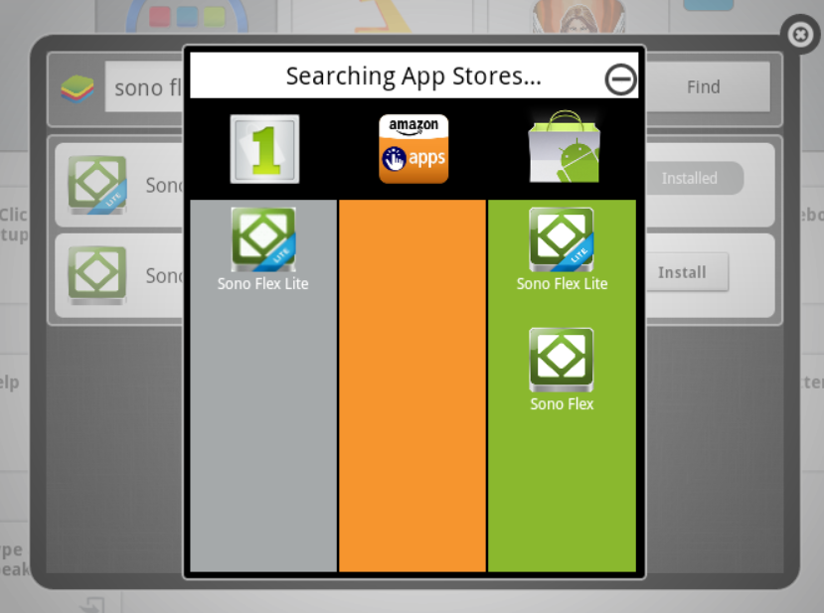
Android Apps
Notes:
There are 3 sources for Android Apps
1 - Mobile Market App Store (~300K)
Amazon Kindle App store (~100K)
Google Play Store (> 700K)
They do not all have the same apps (see slide)

Slide 49
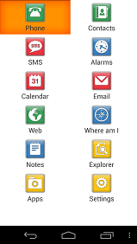
Accessible Android Apps
Big Launcher- icons look darker and text is larger
Vlingo Virtual Assistant and iris. (alpha)- voice command apps
Text to Speech Toy- Text-to- Speech
Eyes-free keyboard
IDEAL web reader
Code Factory - Mobile Accessibility Suite for AT&T users
12 different apps / 30 day free trial -$99
www.androidaccess.net
Notes:
MR

Slide 50
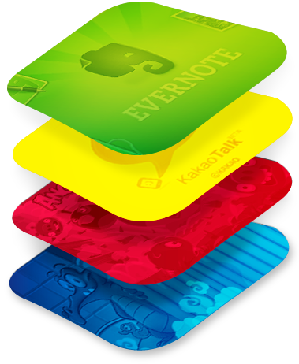
Android App Player for PC
BlueStacks App Player: lets you run apps from your phone fast and full screen on Mac and Windows.
HTTP://www.BlueStacks.com
Notes:
Your PC emulates/ looks like a Samsung Galaxy Tablet
Log in with gmail account just like any android device
Download and try out apps (still have to pay for them)
Demo BlueStacks App Player

Slide 51
TFL AppFinder
Search by:
App Name
Categories
Book
Education
Environmental Adaptations
Hearing
Cognition, Learning, Developmental
Navigation
Personal Care and Safety
Productivity
Communication
Therapeutic Aids
Vision
Notes:
MR

Slide 52
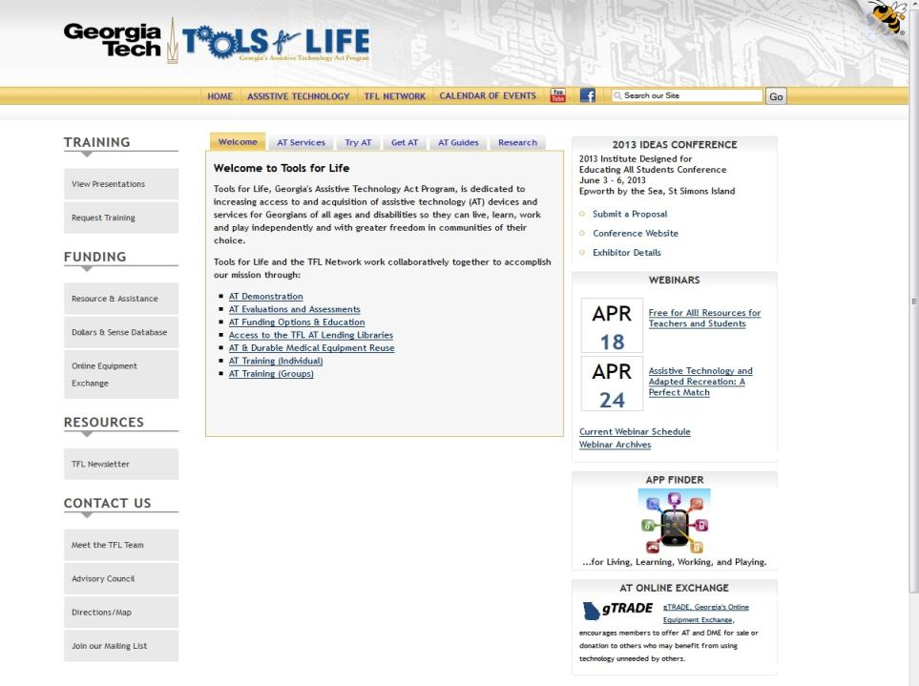

Slide 53
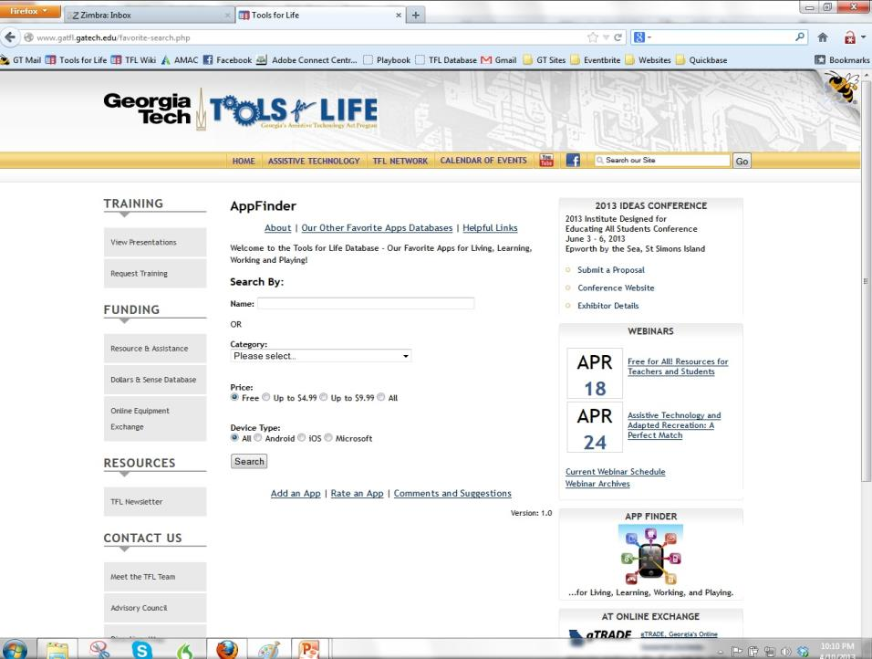

Slide 54
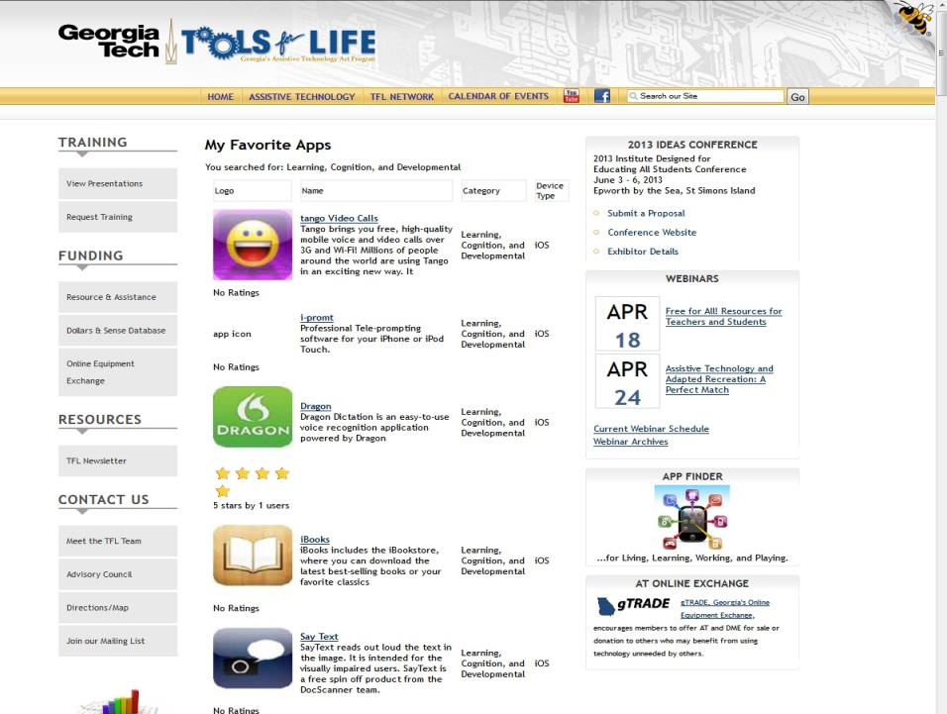

Slide 55
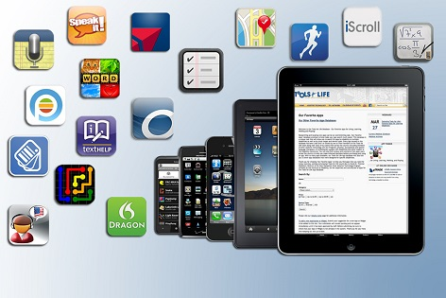
SOME OF OUR FAVORITE APPS!

Slide 56
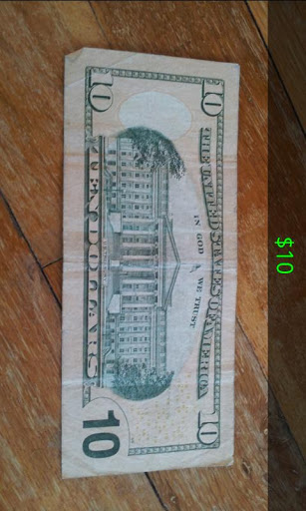
Darwin Wallet
Uses the camera to determine the currency
Hold the bill in front of the phone's camera and the app will speak its value
Free

Slide 57
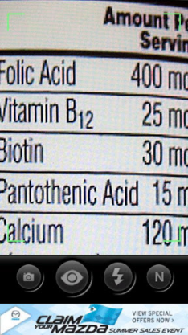
Magnify
FREE
Turns Android phone into a digital magnifying glass with built-in flashlight
Can use gestures anywhere on the screen:
Double-tap: Zoom out/in
Single-tap: Focus
Long-press: Turn light on/off

Slide 58
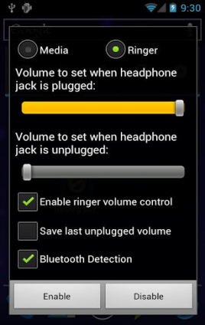
Hearing Saver
Operates in the background to protect your ears automatically
Simple way to avoid accidentally hurting your ears when plugging in or unplugging your Android device's wired or bluetooth headset
Does take time to set-up
FREE

Slide 59
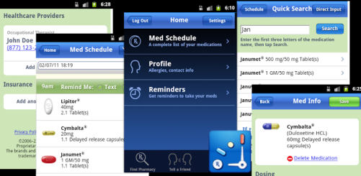
MyMedSchedule
Keep track of medication
Reminders
Refill Reminders
Healthcare Provider Profiles
Insurance Information
Allergies
Works across Platforms
Free
www.mymedschedule.com

Slide 60
Environmental Control
People with mobility impairments can access electronic devices through the Tecla Access Shield

Slide 61
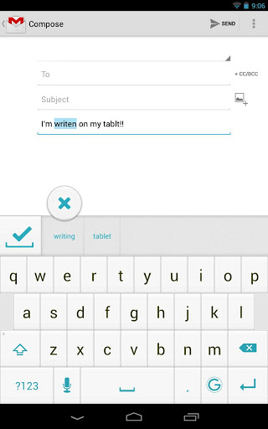
Ginger App
Free
Grammar and Spell checker
Personal Assistant
Use it to correct text messages, Whatsapp messages, Gmail and Outlook emails, and even social media apps such as Facebook

Slide 62
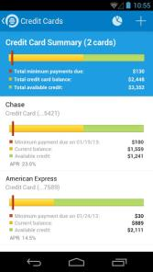
Pageonce
Free
Keep track of your cash and credit cards
Pay your bills
Real-time alerts and reminders about upcoming bills, overage charges, and suspicious transactions
Understand your debt
Notes:
MR

Slide 63
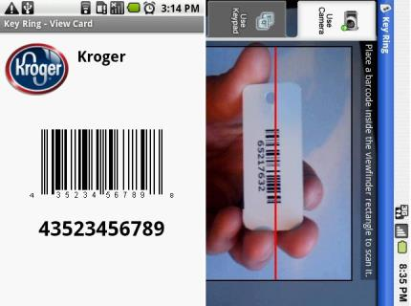
Key Ring
One Place to store all reward cards
Organized
Android & Apple version
www.keyringapp.com
Free!
Notes:
MR

Slide 64
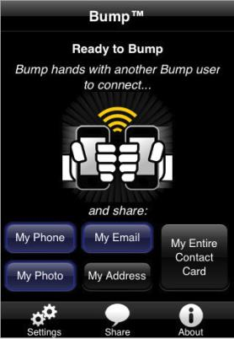
Bump
Use Bump™ to share contact information and photos by simply bumping two phones together.
Just open Bump, hold your phones, and gently bump your hands together
Free!
Demo
Notes:
CL

Slide 65
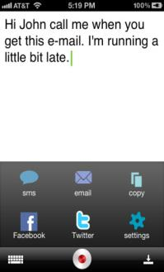
Dragon Dictation
Voice Recognition
Free
Dictate notes, emails, Twitter, and Facebook
Supports many languages
Cut, Copy, Paste
Android
Dragon Go!
Dragon Hands Free Assistant
Notes:
CL

Slide 66
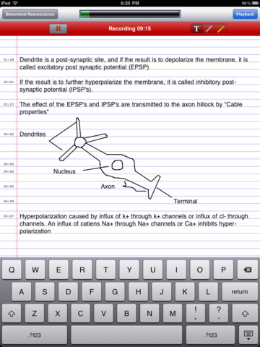
AudioNote
Records your notes, meetings or lectures
Can take notes by typing, stylus, or drawing
Time stamps so you can go directly to where you want to hear
Highlights notes when read back
$4.99
Notes:
CP

Slide 67
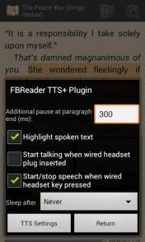
FBReader TTS+ Plugin
Free
eBook Reader
Text-To-Speech plugin for FBReader for Android
Can highlight whole sentences or paragraphs
Change settings for voice and download voices
Notes:
MR

Slide 68
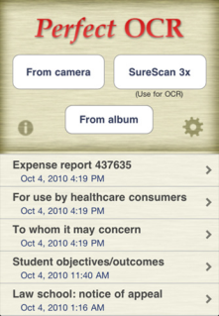
Perfect OCR
$3.99
Uses the built in camera to scan documents
Edit, copy, store, email documents
Upload to online storage is as Evernote
Does take practice for picture
Notes:
CP

Slide 69
iHomework
Keep up-to-date with your school work, grades, to-do's, teacher's information
School organizer that can be with you anywhere you go, whether that be on your iPhone/iPod touch, iPad, or Mac

Slide 70
Reminders
Built-in App
Works with VoiceOver
Organize your reminders
Siri if have iPhone 4s or 5
The new iPad
Notes:
CP

Slide 71
MyScript Calculator
Use your handwriting to write any arithmetic formula
Write and calculate mathematical expressions in with no keyboard
Scratch-out gestures to easily delete symbols and numbers
Portrait and landscape operation
Redo and undo functions

Slide 72
Money Counter Calculator
iPad only
Enter amount of coins and dollars and total is provided
Free

Slide 73
Picture Scheduler
Create visual tasks with attached audio, video or picture
Tasks can have alarms
Alarms can be repeated daily, weekly, monthly or you can select specific weekdays
Tasks can be organized into categories with a picture
Can hide task and reveal later

Slide 74
Speak it!
Copy emails, documents, web pages, PDF files, and more; paste them into Speak it!, and have the text spoken back to you.
Email text to speech files
Make announcements over PA system
Endless phrases and possible uses
$1.99

Slide 75
BrailleTouch
Prototype app for touchscreen mobile devices
FREE Open Source app
32 words per minute with 92% accuracy with the prototype app for the iPhone
Use of the six-key configuration so that the keyboard fits on the screen and users keep their fingers in a relatively fixed position while texting
GA Tech Researchers
Type with screen facing away
Braille like typing

Slide 76
LookTel Money Reader
iOS App
$1.99
Uses camera
Speaks out loud
Do not need to hold bill steady or in entire frame

Slide 77
iZen Garden
Choose from 100s of objects, plants and creatures to place in your garden
Rake the sand and share your creations
Helps you to center your mind, relax your psyche and relieve your stress

Slide 78
Talk with Us! What are Your Favorite Apps?

Slide 79
Our Question to You: What have You Learned today?
Notes:
79

Slide 80
Contacts
Liz Persaud: Training, Development and Outreach Coordinator
Liz.Persaud@gatfl.gatech.edu
Martha Rust: AT Specialist
Martha.Rust@gatfl.gatech.edu
Ben Satterfield: AT Specialist, Trainer, Research Consultant
Ben@gatfl.org
Disclaimer
This presentation is produced by Tools for Life which is a result of the Assistive Technology Act of 1998, as amended in 2004. It is a program of the Georgia Institute of Technology, Enterprise Innovation Institute [EI2], Alternative Media Access Center (AMAC) and is funded by grant #H224C030009 of the Rehabilitation Services Administration (RSA), Department of Education. The contents of this presentation were developed under a grant from the Department of Education. However, those contents do not necessarily represent the policy of the Department of Education, Georgia Tech, EI2 or AMAC and you should not assume endorsement by the Federal government.

